Slide 1
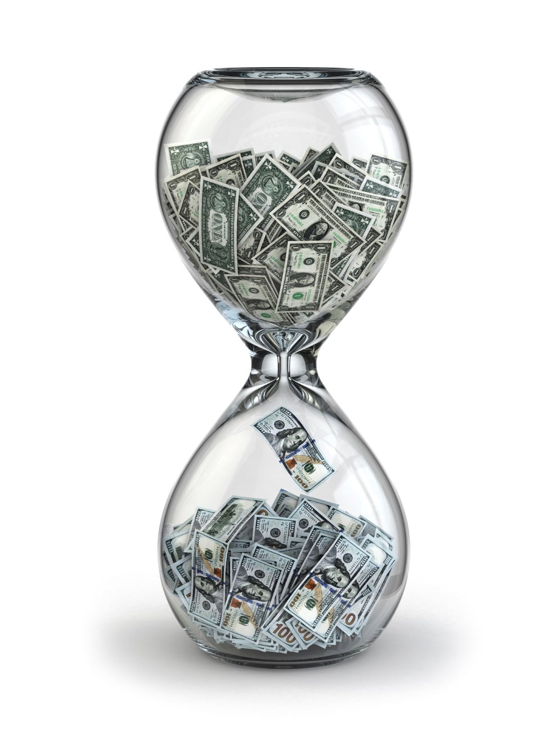
Time Management
Spend more time on prospects who are more likely to buy.

Slide 2
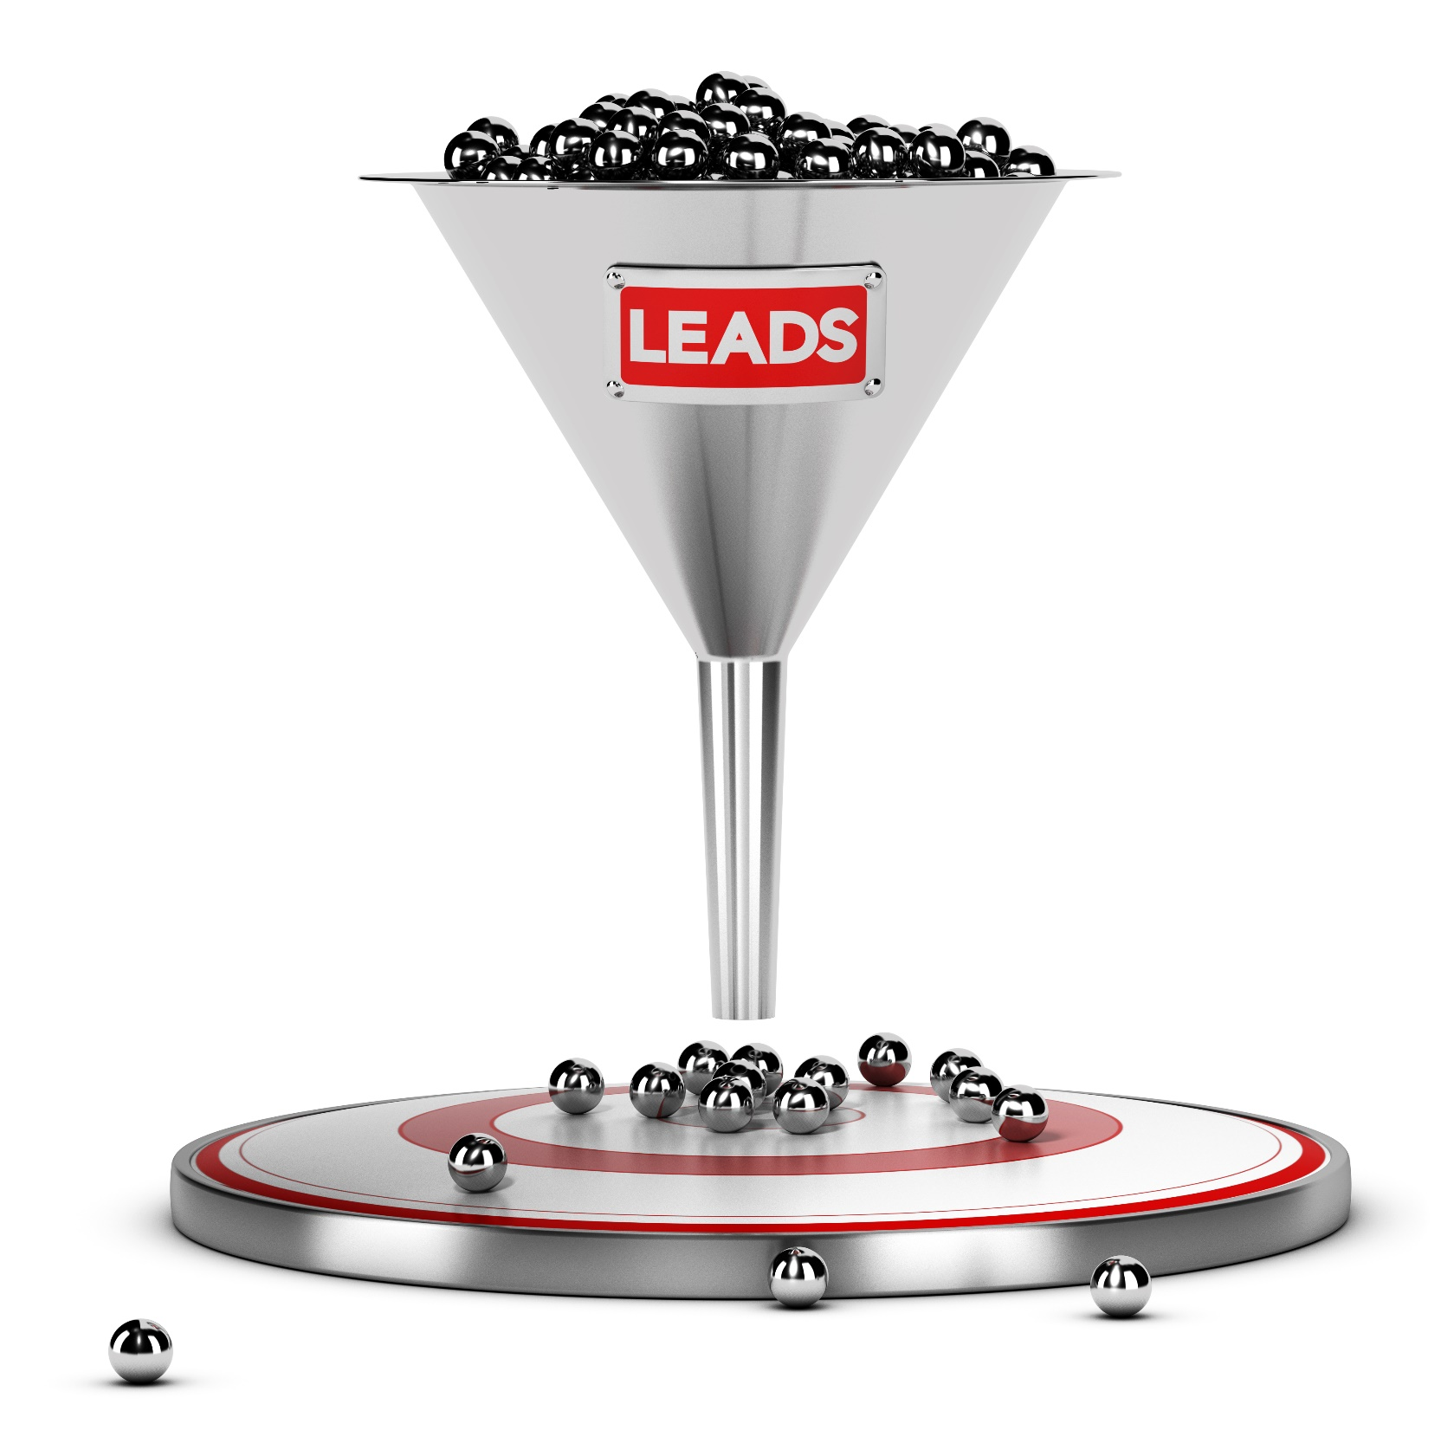
Sales people have to prioritize sales prospects, existing customers, administration, and the many other tasks on their plate.

Slide 3
Discussion: “Where do you spend the most amount of your time today?”
• Do you feel overwhelmed? Do you feel as though you don’t have enough time in the day?
• What time management techniques do you use or have used in the past? Do they work? Why or why not?
• Do you make extra time for sales? How?
• If you don’t make time for sales, why not?
• What is the one thing that you plan on doing next week to help make more time available for selling?

Slide 4
The Goal
Have better time management within your sales force.

Slide 5
Key Points
Making time for sales
Prospect priorities
Example
What not to do
Your next steps
Wrap up

Slide 6
Worksheet
Grab your worksheet and follow along.

Slide 7
Make Time For Sales
Maintaining momentum
Not seen as only reaching out when necessary and the pipeline is empty
Creating a routine for yourself
Constantly learning and growing

Slide 8
Priority 5: Prospecting
The first stage of prospecting, figuring out which prospects to approach, usually has a 1% conversion.
You should spend about 1% of your time looking for leads.

Slide 9
Priority 4: Qualifying
The second, qualifying, has a 10% chance of converting.
Figure out what information your prospects need at this stage and create standard responses and marketing collateral to reduce how much time you have to spend with these prospects.

Slide 10
Priority 3: Presentations
Third is the presentation stage, with a 25% chance of conversion. Spend more of your time here.

Slide 11
Priority 2: Quotations
Fourth is a quotation, which could have a 50-70% conversion rate, depending on how many providers are bidding against you and on your past experience at this stage.

Slide 12
Priority 1: Close
Since the chance of closing here is 100% and the chance of getting more sales or referrals is high, the majority of your time should be spent with customers at this stage.

Slide 13
Discussion: “Why do some of your customers take more time than others?”
Are there some customers that don’t seem to close? Customers that require multiple face to face visits prior to signing a contract?
Are there ways to mitigate your risk (your time) involved in this?
Do you have customers that contact you more frequently by email? By phone? Face to face?
Are there ways to mitigate your risk (your time) in this?

Slide 14
How Does It Work? Gift Baskets
Weekly Goal | Day | Things To Do | Sales Activity
Get a 2 new customers | Monday | Reply to all emails Paperwork | Cold calling for 2 hours
 | Tuesday | Take administrator out for coffee | Breakfast networking event
 | Wednesday | Training session | Follow up with leads from networking event
 | Thursday | Team meeting | Send out proposals
 | Friday | Banking | Follow up with existing customers
 | Saturday |  | Make a referral
 | Sunday |  | Figure out next week’s goals & activities

Slide 15
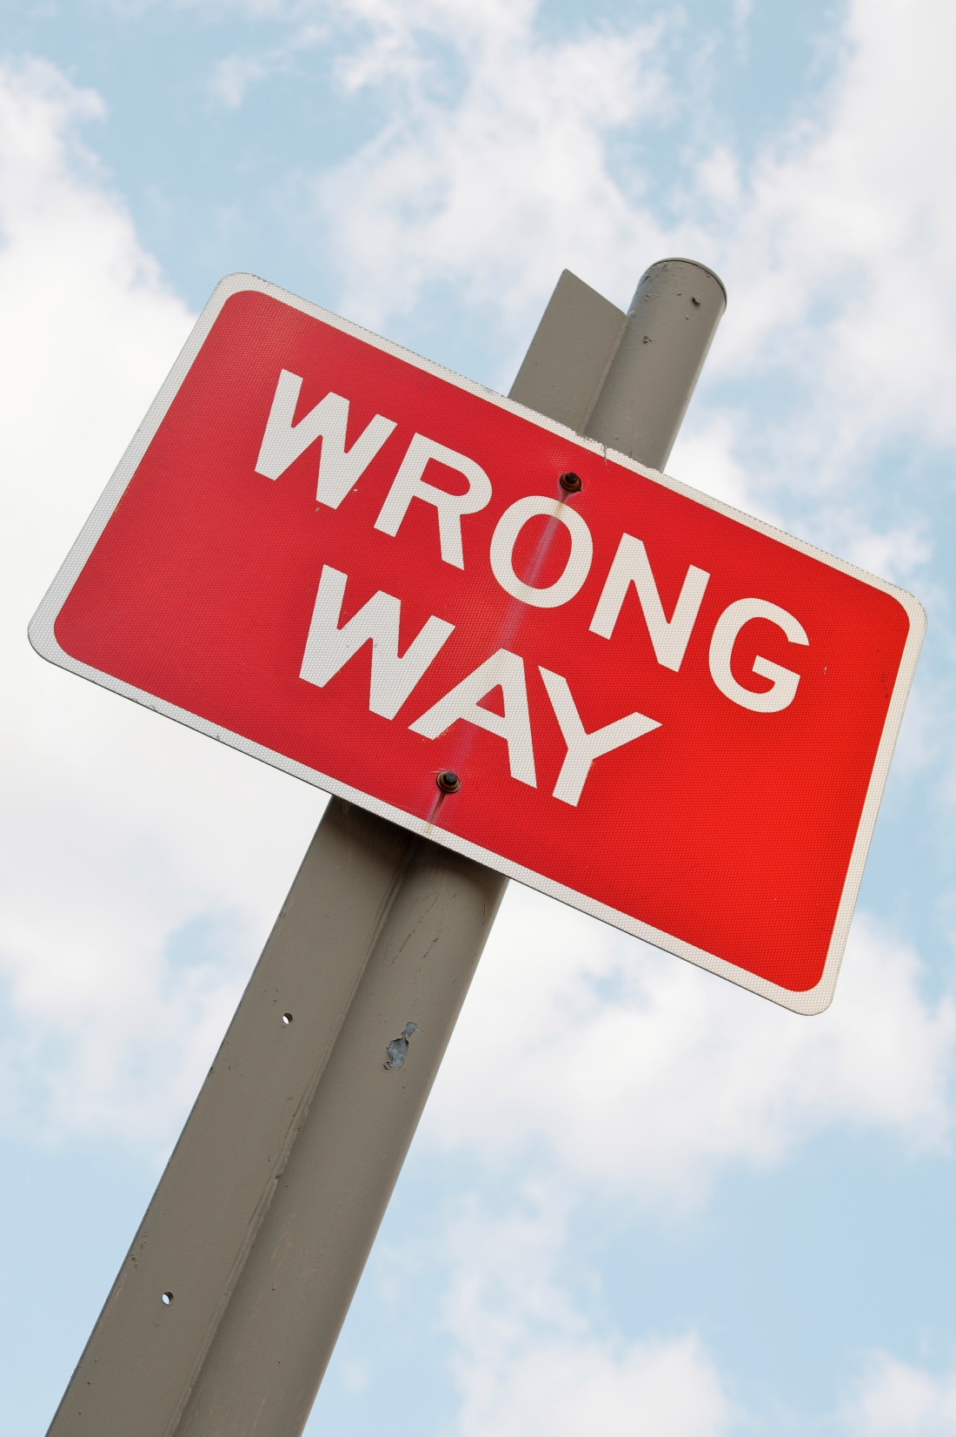
Top Mistakes To Avoid
Not making time for selling
Losing momentum in your sales funnel
Prioritizing prospects and leaving your higher probability clients to wait

Slide 16
Now What?
Make time.
Spend more time on higher probability customers.
Never forget your existing customers!

Slide 17
Worksheet
How does this work for your business?

Slide 18
Discussion: “How do you prioritize your time?”
What tools have you tried? (To do list, calendars, other IT, small wins, doing 1 strategic initiative per week, outsourcing, personal assistant, delegation tactics, delay tactics, focusing, etc.)
How many hours do you delegate to sales?
How do you make time to improve your sales strategy and delivery?

Slide 19
Key Points
Making time for sales
Prospect priorities
Example
What not to do
Your next steps

Slide 20
The Goal
Have better time management within your sales force.

Slide 21
Spend more time on prospects who are more likely to buy.

