Slide 1
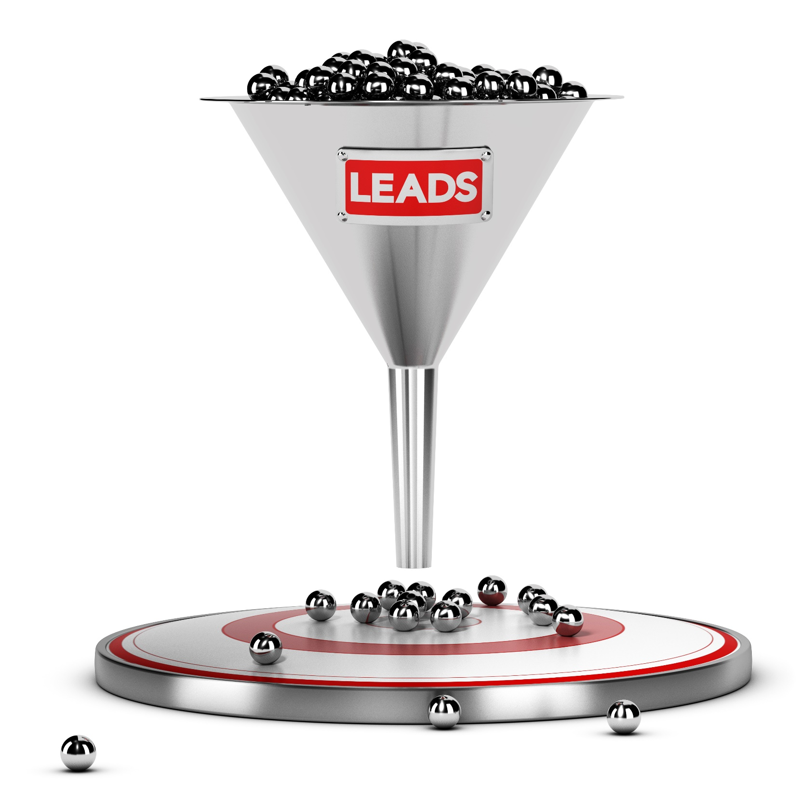
Sales Cycles
Shortening the sales cycle, increases your sales.

Slide 2
Why?
The more quickly you can close a prospect, the more time you have to invest in other customers
The longer a prospect stays in the funnel, the less likely they will be to buy.

Slide 3
The Goal
Shorten your sales cycle.

Slide 4
Key Points
Qualify
Awareness
Interest
Close
Follow-Up
Example
What not to do
Your next steps
Wrap up

Slide 5
Worksheet
Grab your worksheet and follow along.

Slide 6
Qualify
Figuring out if a customer is likely to buy from you
How do you do this?
Lead lists
Lead research
Asking direct questions

Slide 7
Awareness
Getting prospects to know about your business
How do you do this?
Networking
Advertising
Cold calling
Direct mail

Slide 8
Interest
Getting a prospect to be interested in learning more
How do you do this?
Presentations
Videos
Compelling messaging

Slide 9
Close
Having a prospect buy
How do you do this?
Confidence
Reducing risk
Overcoming objections
Credibility
Trust

Slide 10
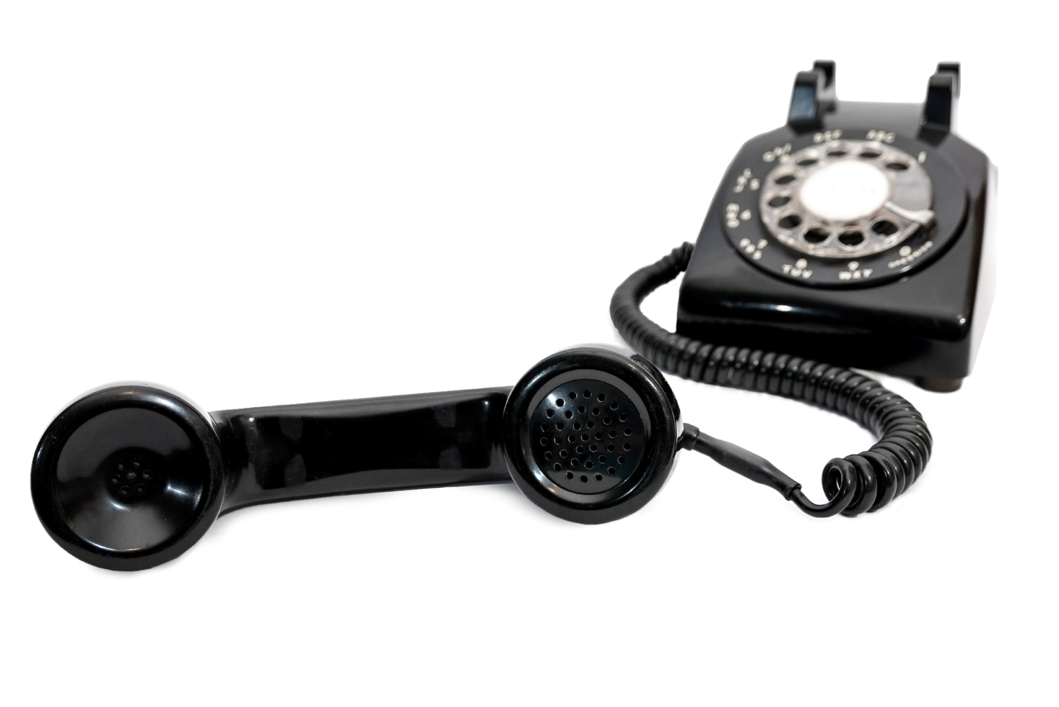
Follow-Up
Continuing the relationship with an existing customer
How do you do this?
Newsletters
Meetings
Customer events
Telephone calls

Slide 11
Discussion: “What Is The Duration of Each Stage?”
Are the stages typically the same length?
Are some longer than others?
How much longer? Why?
Are some stages shorter than others?
How much shorter? Why?

Slide 12
How Does It Work? : Paralegal
# of Leads | Stage | How Do You Do This? | Conversion Rate | How To Improve
100 | Qualify | Type of industry |  | Size of business
20 | Awareness | Calling | 20% | Website
10 | Interest | Meeting | 50% | Brochure
3 | Close | 100% performance | 30% | Referrals
30 | Follow Up | Monthly reports |  | Meetings

Slide 13
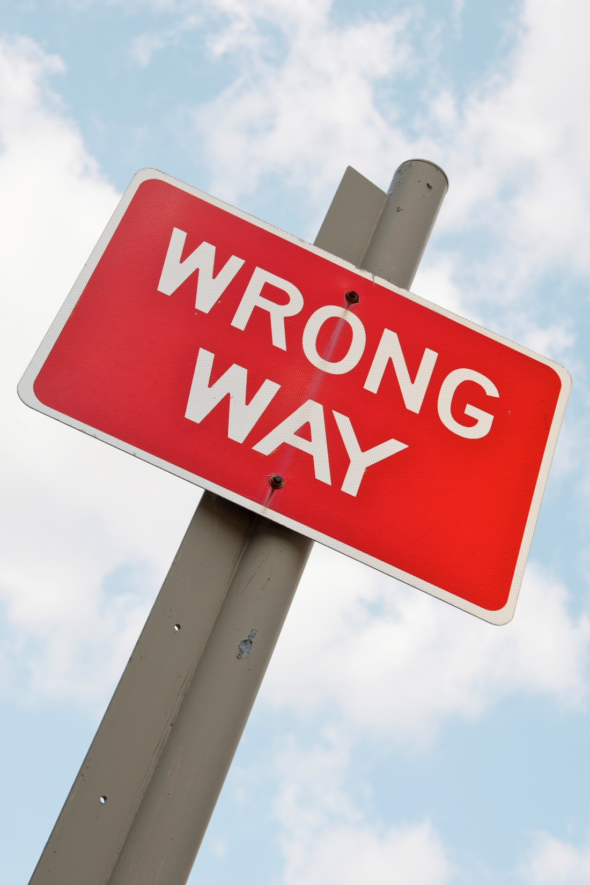
Top Mistakes To Avoid
Not benchmarking
Trying to improve everything at once
Forgetting that it still a numbers game
Taking it too personally when you don’t close a customer – analyze!

Slide 14
Now What?
Referrals reduce your sales cycle
Your existing personal contacts reduce your sales cycle
Have a goal for each time you contact a prospect—keep up momentum!

Slide 15
Worksheet
How does this work for your business?

Slide 16
Discussion: “For Your Longest Stage, Why Is It Taking A Long Time?”
Is it delayed due to a common factor you’ve seen in multiple prospects?
Is it delayed for the same objection as you’ve seen in multiple prospects?
Is it delayed due a lack of follow up?

Slide 17
Discussion: “How Could You Speed Up Your Other Stages?”
Think about a time it happened quickly. Why did the stage happen so quickly?
Is there any of your customer that could offer insight or feedback on your sales funnel?
Could you work with another sales person who is great at a stage you might be having trouble with?
Could you consider team selling to get feedback from another sales associate?

Slide 18
Key Points
Qualify
Awareness
Interest
Close
Follow-Up
Example
What not to do
Your next steps
Wrap up

Slide 19
The Goal
Shorten your sales cycle.

Slide 20
Shortening the sales cycle, increases your sales.
www.SmallBusinessSolver.com © 2016

