Slide 1
Know When To Walk Away
There are plenty of fish in the sea. And not everyone is right for you.

Slide 2
There comes a tipping point where too much time, energy, emotion, money, connections, favours, and a whole host of other resources have been poured into a customer.

Slide 3
Discussion: “Do you have a customer that has been in the sales funnel forever?”
Why has it taken a long time to close them?
Why aren’t they moving forward?
How does this make you feel?
Is it worth it?
Should you disengage or keep trying?
How could you disengage?

Slide 4
Discussion: “How Could You Generate Action?”
Is there a direct question you could ask?
Did you need to change your approach?
Is there still risk or objectives that have not been overcome?
Is there a way to take a baby step forward?

Slide 5
The Goal
Have a walking away point that protects you and your business.

Slide 6
Key Points
Red Flags
Front-page news
Decision-maker
Relationship
Stalemate
Goal
Cash flow
Example
What not to do
Your next steps
Wrap up

Slide 7
Worksheet
Grab your worksheet and follow along.

Slide 8
Front-page News Flag

Slide 9
Decision-Maker Flag

Slide 10
Relationship Flag

Slide 11
Stalemate Flag

Slide 12
Goal Flag

Slide 13
Cash Flow Flag

Slide 14
How Does It Work? Homemade pet treats
Priority | Customer | Red Flag | De-Marketing Strategy
1 | Large grocery store | Decision-maker flag | Contact CEO of business
2 | Local convenience store | Cash flow flag | Explain that the credit terms on cash upfront
3 | Large pet food chain | Goal flag | Write email with quote that quality is focus rather than lowest cost
4 | Local pet store | Relationship flag | Put on newsletter

Slide 15
Discussion: “Do you have any warning signs/red flags?”
Could you spot those warning signs again?
Could you even guess a type of customer that might do this?
Are you willing to hold on?
When do you check in to re-assess?

Slide 16
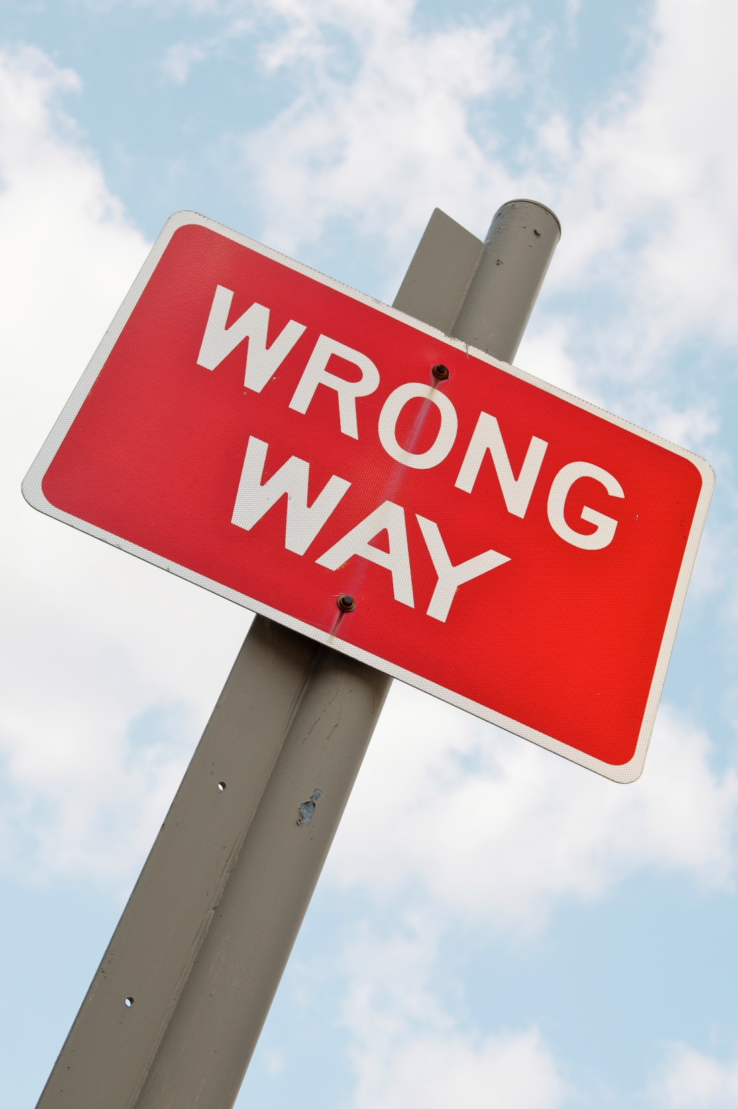
Top Mistakes To Avoid
Ignoring your gut
Putting all your eggs in one basic
Thinking that you can please everyone
Ignoring the signs

Slide 17
Now What?
Drop a bad customer sooner than later.
Allocate your time based on sales probability.
Watch for red flags!

Slide 18
Worksheet
How does this work for your business?

Slide 19
Key Points
Red Flags
Front-page news
Decision-maker
Relationship
Stalemate
Goal
Cash flow
Example
What not to do
Your next steps

Slide 20
The Goal
Have a walking away point that protects you and your business.

Slide 21
There are plenty of fish in the sea. And not everyone is right for you.
www.SmallBusinessSolver.com © 2016

