Slide 1
Networking
Networking is one of the best (and easiest)
ways to generate sales leads.

Slide 2
Not every networking is good for your business.

Slide 3
Discussion: “Why do you go to networking events?”
Are you going to meet potential customers?
Are you going to meet potential channel partners?
Are you going to find finance partners?
Are you going to learn?
Is there someone specific you need to meet?

Slide 4
The Goal
Be prepared to get the most out of every networking event you attend.

Slide 5
Key Points
Prepare
Arrival
Meeting people
Exchanging cards
After event
Example
What not to do
Your next steps
Wrap up

Slide 6
Worksheet
Grab your worksheet and follow along.

Slide 7
Prepare
Decide up front who you want to meet.
Figure out what type of networking event is best for you.

Slide 8
Arrival
Always arrive early.
Make yourself different.

Slide 9
Meeting People
Have a 30-second pitch ready.
If you are by yourself, look for newcomers to the event or others standing by themselves.
Listen first, talk second.

Slide 10
Discussion: “What do you do at events to ensure that you meet these people?”
How do you select people to speak with?
How do you prioritize your contacts that you’ve met?
How do you build the relationship when you first start speaking? As your conversation progresses?
Is there a way to ensure that you get introduced to the contacts you are looking for? Can you find advocates to help you at the event?

Slide 11
Exchanging Cards
Take a serious look at their card.
Write notes about your conversation on the back of the card.
Put all of your cards in a safe place.

Slide 12
After Event
Quick follow-up is the best thing to do.
Catalogue the contacts.
Evaluate the event that you went to.

Slide 13
Discussion: “What do you do after an event?”
How do you remember who was who?
When do you follow up?
When do you contact the most important contacts?
How do you contact them?
Are there any people you don’t follow up with?

Slide 14
How Does It Work? Real estate lawyer
Who do you want to meet? Real estate agents
What are the best networking events?
Real estate associations
Real estate agent annual general meetings
Local networking groups

Slide 15
How Does It Work? Real estate lawyer
30-Second Pitch for Real Estate Agents
I’m ABC Law Group where we do real estate law and partner with real estate agents. Everyone who buys or sells a house needs a lawyer, and unlike the competition we specialize in this industry making the process 100% hassle free guaranteed.
Which event was the best?
Local networking groups.

Slide 16
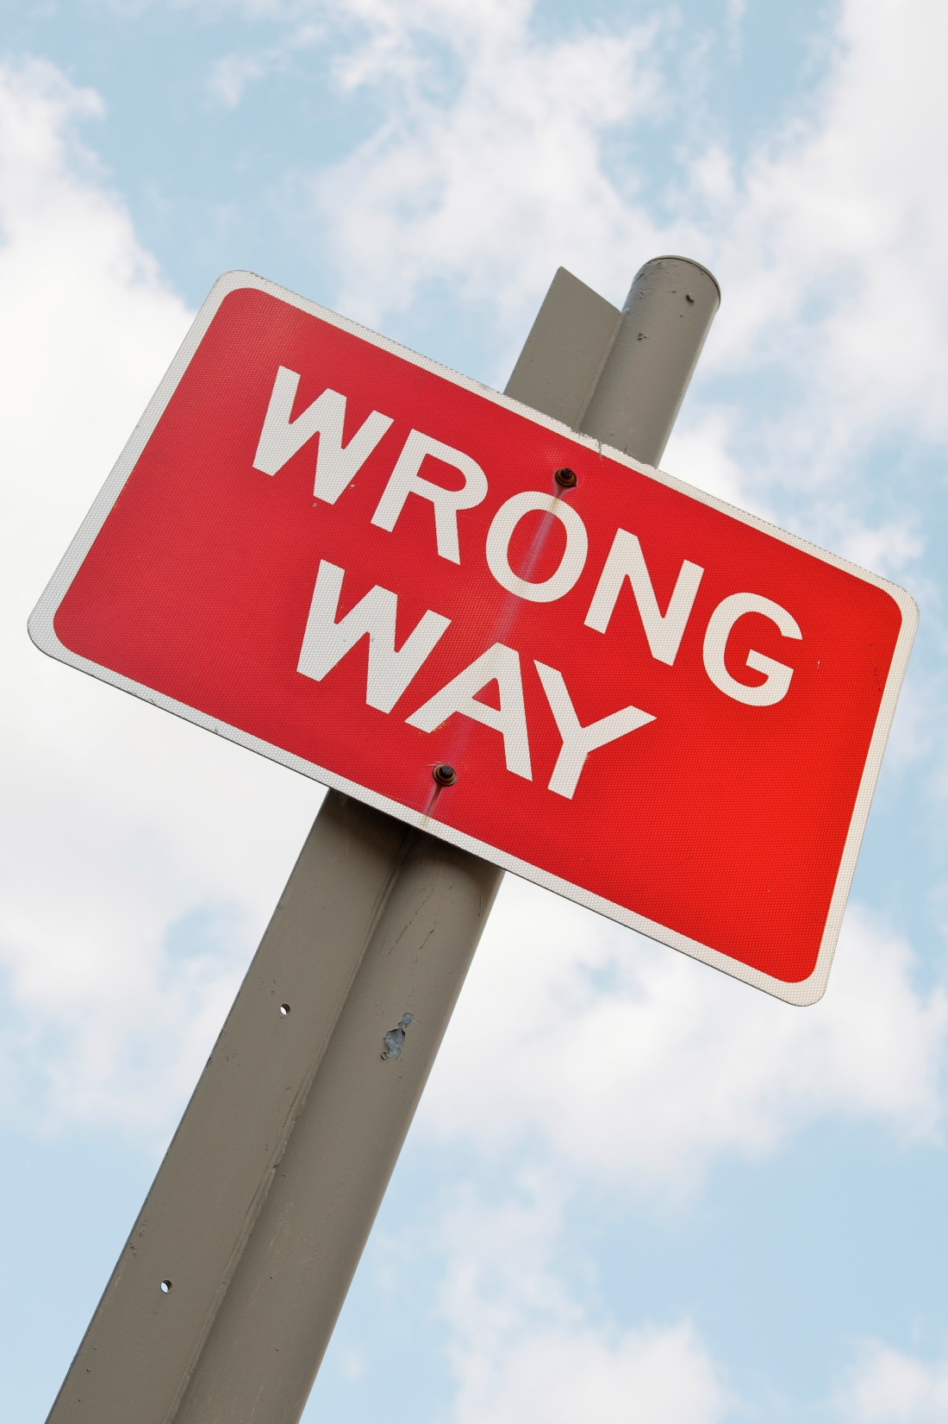
Top Mistakes To Avoid
Going to every event!
Meeting lots of people but not following up
Not knowing who you are looking to meet
Thinking that networking is a short term thing

Slide 17
Now What?
Be genuine.
Use your two ears and one mouth in proportion.
Choose networking events carefully as they take up time and money.
Double your networking by finding great networkers and telling them what you do.
If they like what you say, they will start networking for you!

Slide 18
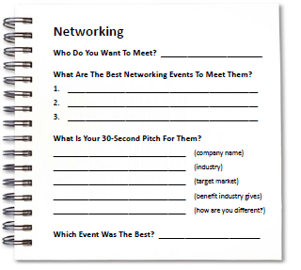
Worksheet
How does this work for your business?

Slide 19
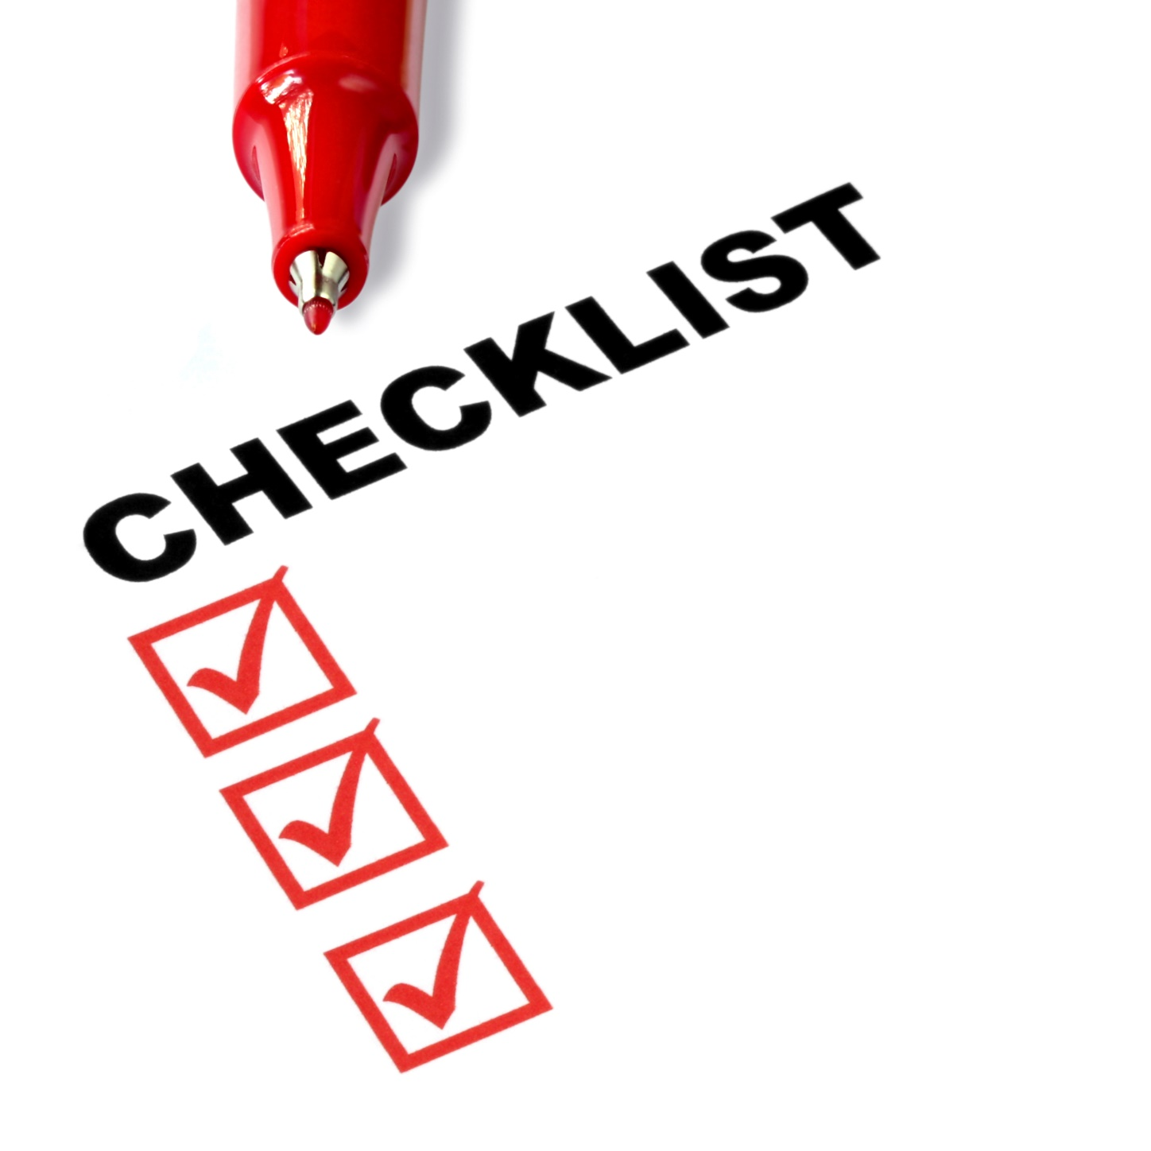
Key Points
Prepare
Arrival
Meeting people
Exchanging cards
After event
Example
What not to do
Your next steps

Slide 20
The Goal
Be prepared to get the most out of every networking event you attend.

Slide 21
If your networking isn’t working, fix it.
www.SmallBusinessSolver.com © 2016

