Slide 1
Lead List Research
Knowing more information about your customer can help you with a sale.
www.SmallBusinessSolver.com © 2016

Slide 2
It proves to them that you are interested in them, you understand them, and that you are different from other sales people.
www.SmallBusinessSolver.com © 2016

Slide 3
The Goal
Learn to use research to make yourself stand out.
www.SmallBusinessSolver.com © 2016

Slide 4
Discussion: “What do you need to know?”
Can you find the name and position of the person you wish to speak with?
Do you know anything about what is important to your prospect? What association are they part of? Have they volunteered for something? Is there any clue as to what they are passionate about?
What is the prospect`s frame of reference? What is their work experience, education and overall background?
www.SmallBusinessSolver.com © 2016

Slide 5
Key Points
Show interest in the customer
Understand the customer
Differentiate yourself
Example
What not to do
Your next steps
Wrap up
www.SmallBusinessSolver.com © 2016

Slide 6
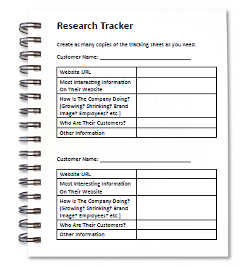
Worksheet
Grab your worksheet and follow along.
www.SmallBusinessSolver.com © 2016

Slide 7
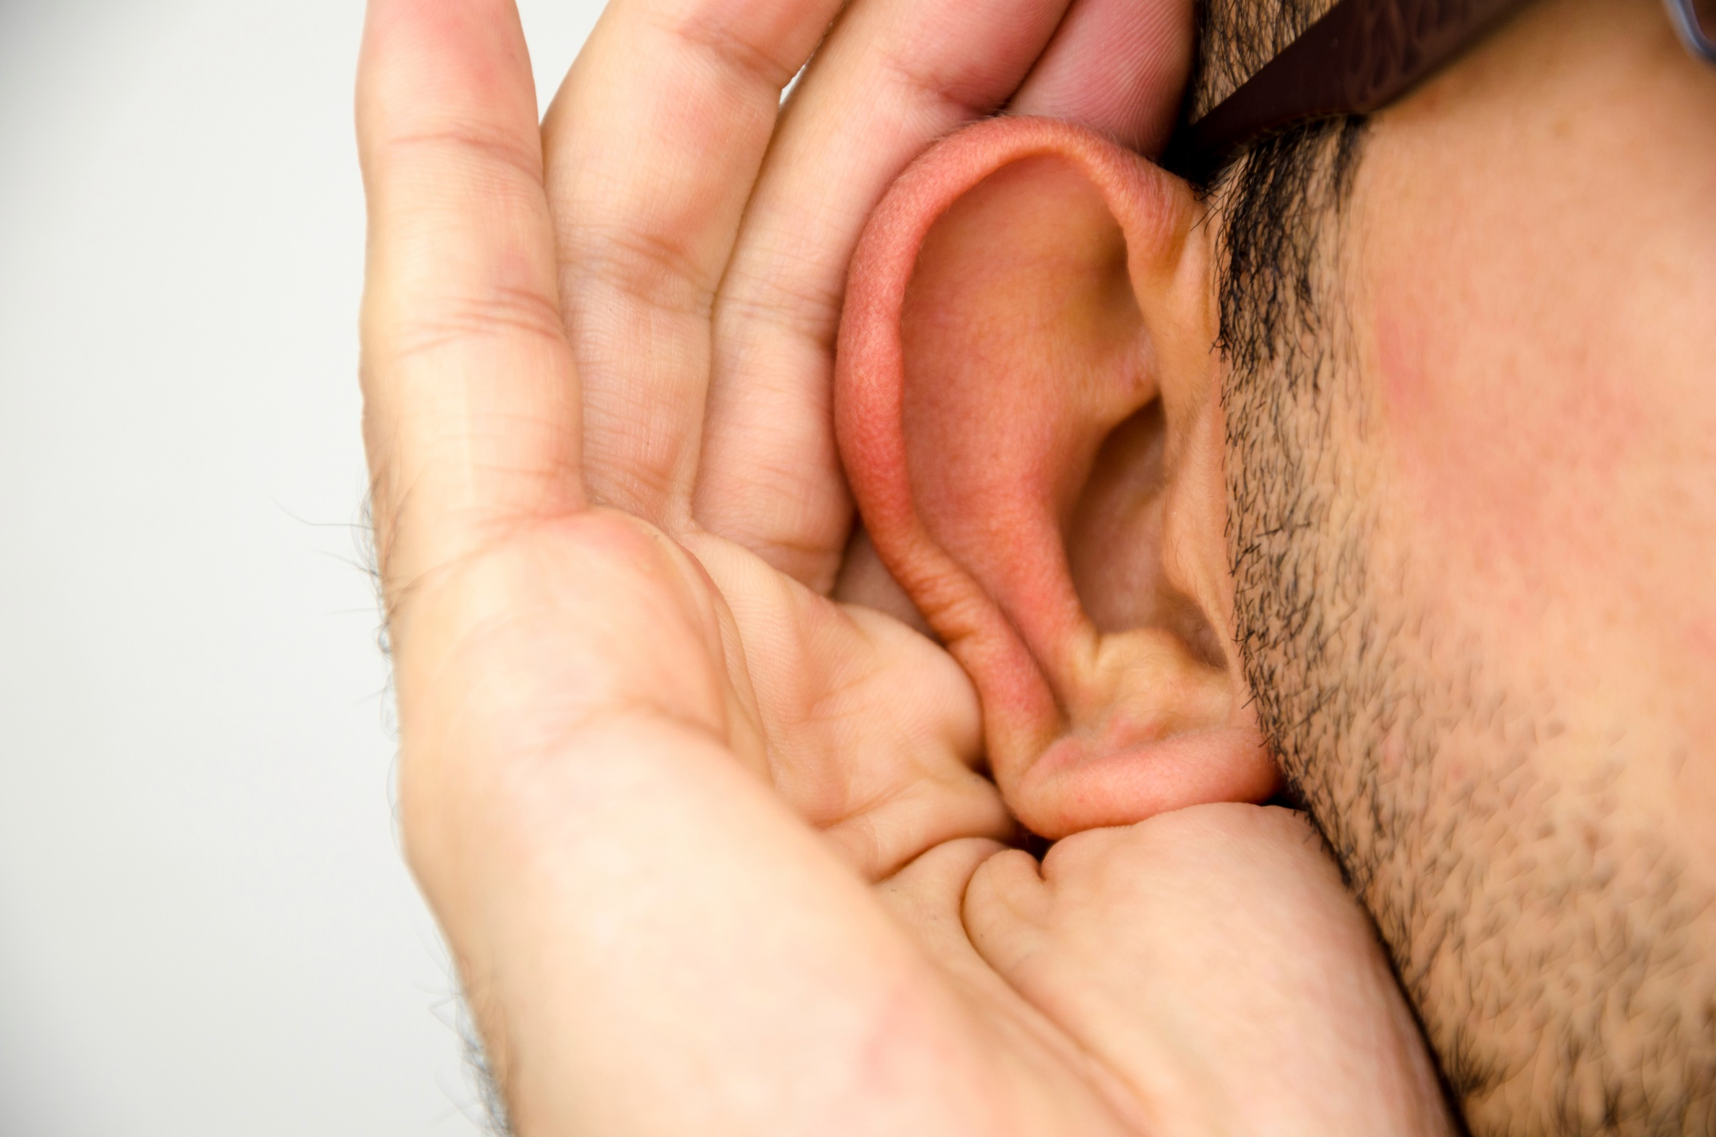
Show interest in the customer
www.SmallBusinessSolver.com © 2016

Slide 8
Understand the customer
www.SmallBusinessSolver.com © 2016

Slide 9
Differentiate yourself
www.SmallBusinessSolver.com © 2016

Slide 10
Discussion: “What is a waste of time to research?”
What is the probability that you will get a sale? If they are further along or more interested, you should do more research.
How big is the potential? The bigger the customer, the more research you should do.
Do you investigate every customer? Are they all qualified? You could do research just to qualify and save the energy on picking up the phone.
www.SmallBusinessSolver.com © 2016

Slide 11
How Does It Work? Catering
Company Name: Event venue
URL: www.eventvenue.web
Interesting Information: They have a theatre and are one of the oldest buildings in town.
How are they doing? Been in existence for many years, but seem to be looking for new ideas.
Who are their customers? Enterprises, weddings, non profits
Other information: Don’t offer healthy eating options.
www.SmallBusinessSolver.com © 2016

Slide 12
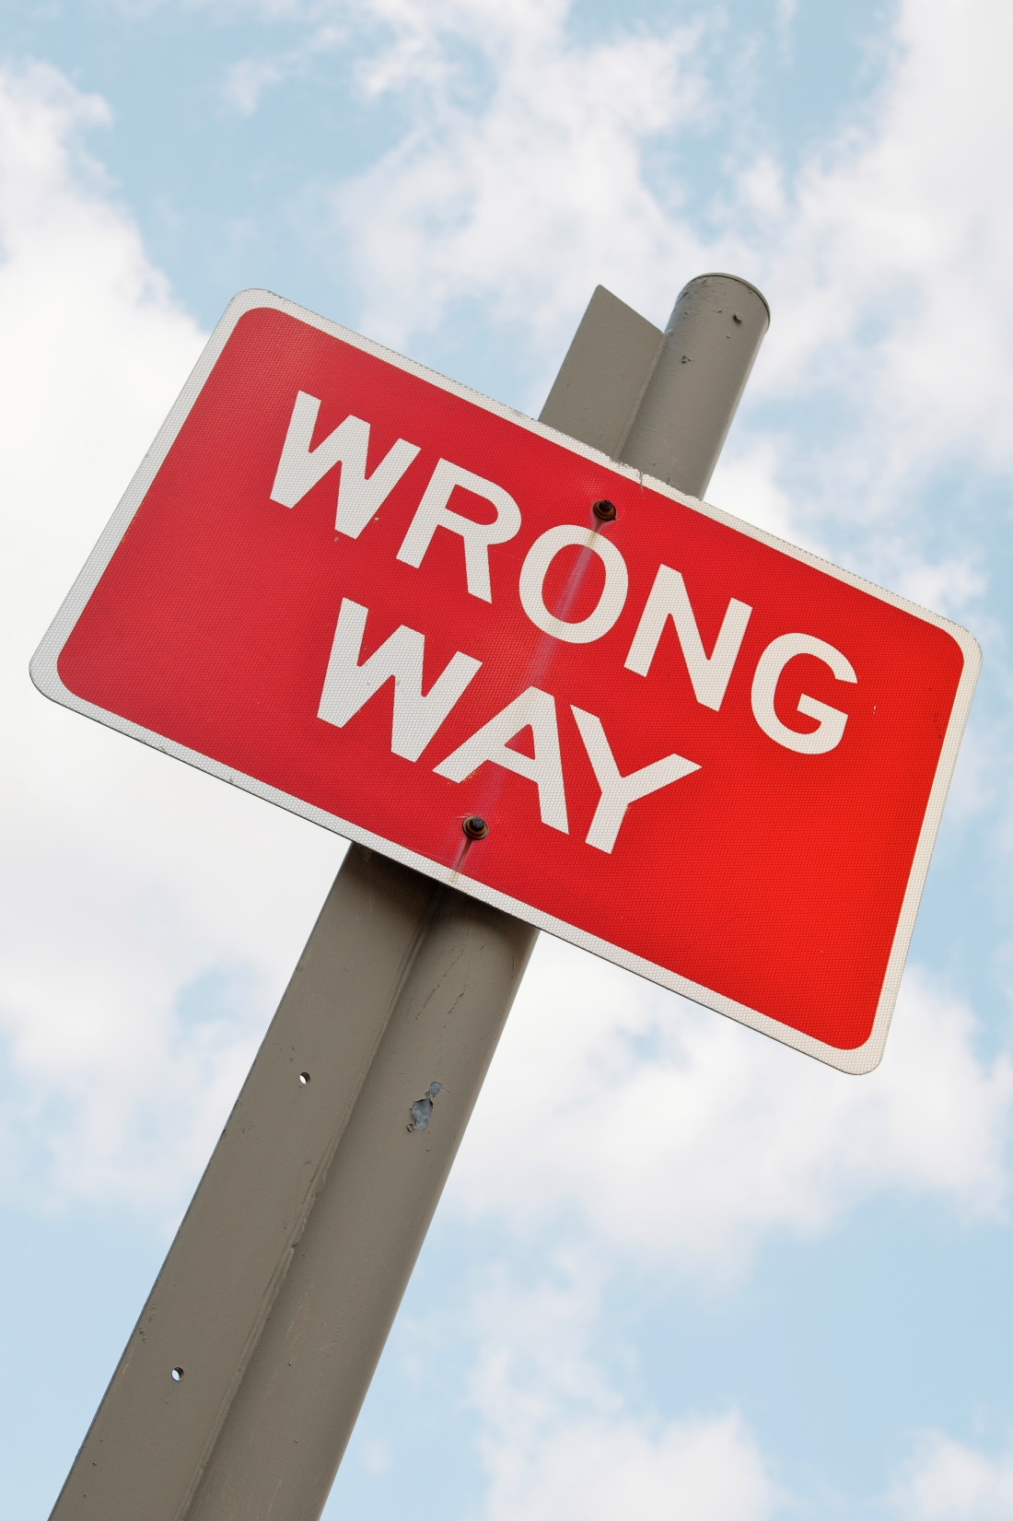
Top Mistakes To Avoid
Just reaching out to someone blindly
Not spending the effort to learn more
Not wanting to learn more
Blending in with other sales people
www.SmallBusinessSolver.com © 2016

Slide 13
Now What?
A good sales person usually spends 1/3 of their time researching and 2/3 selling.
Research is a differentiator.
When using research, minimize you’re the range of study to what is needed.
www.SmallBusinessSolver.com © 2016

Slide 14
Discussion: “Where can you get this information?”
Can you find information about the company or your contact on the website?
Is your contact on LinkedIn? Or maybe you can learn about other employees at the organization through LinkedIn.
Are they in you network and could you actually get an introduction? This helps with their experience and background.
What happens when you Google them? This could help you find out associations and what they are passionate about.
Could you leverage Facebook? Is this too personal?
What’s too much information?
www.SmallBusinessSolver.com © 2016

Slide 15
Worksheet
How does this work for your business?
www.SmallBusinessSolver.com © 2016

Slide 16
Key Points
Show interest in the customer
Understand the customer
Differentiate yourself
Example
What not to do
Your next steps
Wrap up
www.SmallBusinessSolver.com © 2016

Slide 17
The Goal
Learn to use research to make yourself stand out.
www.SmallBusinessSolver.com © 2016

Slide 18
Knowing more information about your customer can help you with a sale.
www.SmallBusinessSolver.com © 2016

