Slide 1
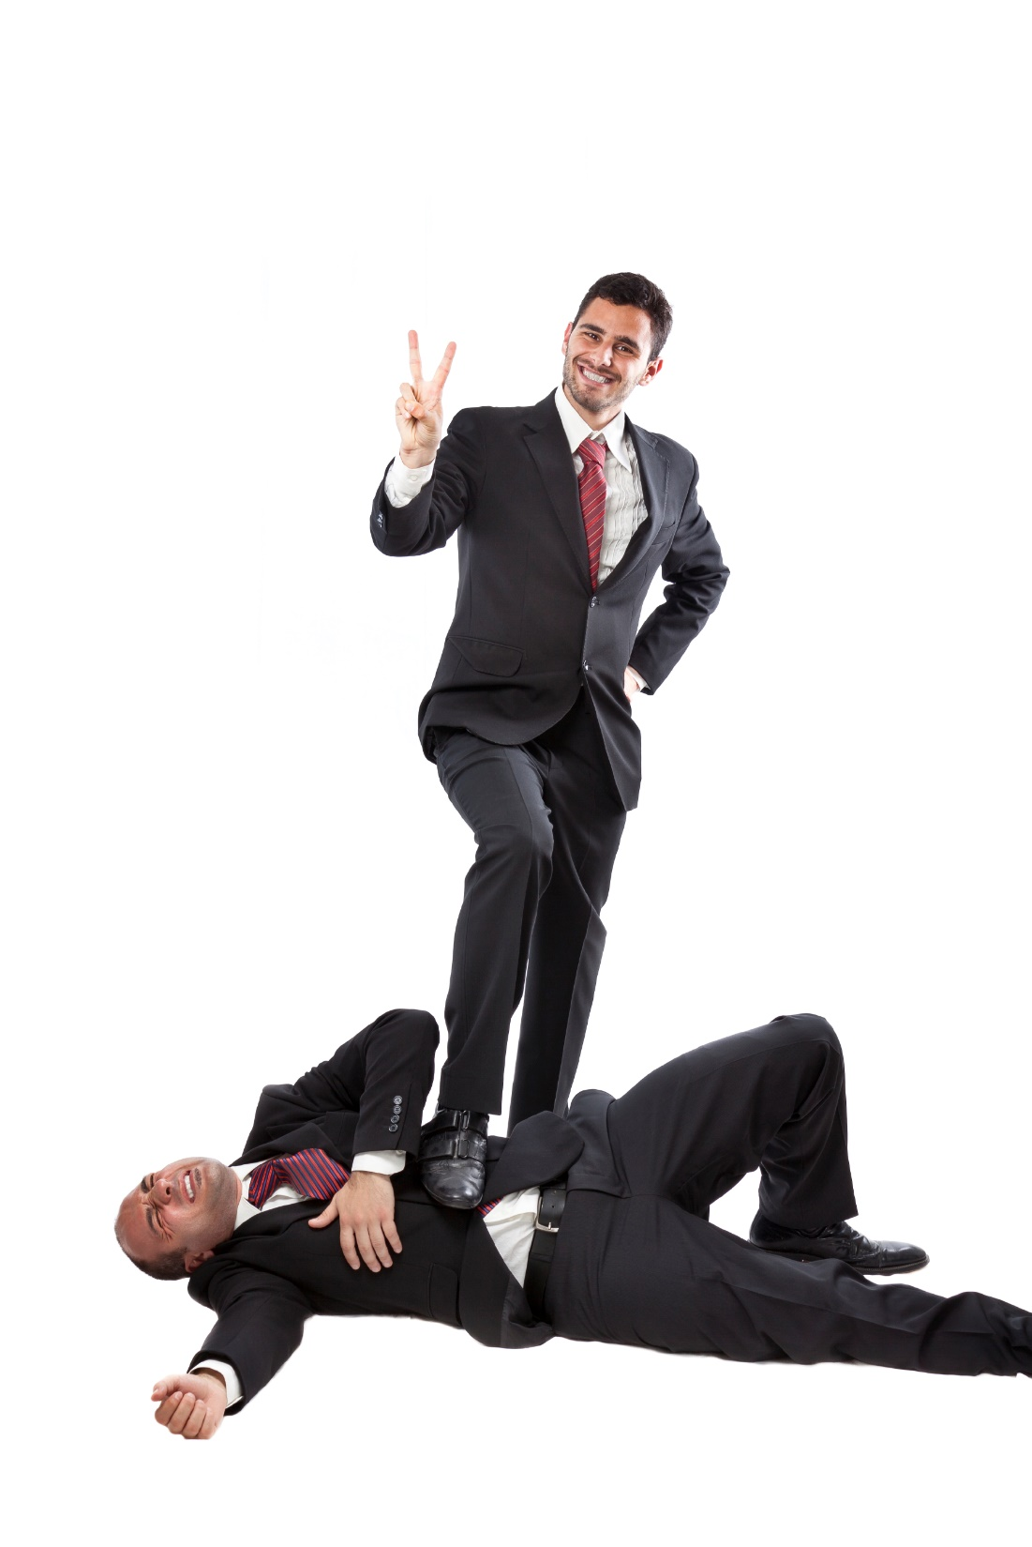
Standing Up For Yourself
The Slippery Slope

Slide 2
Would you give a price discount or work for free?
For your business you want to make your first sale and you are having a hard time getting your first customer.

Slide 3
Would you keep working with the customer?
That customer doesn’t refer business to you and now expects that lower price all the time.

Slide 4
Would you go to a new bank hide your bad credit the best you can?
You need money to improve your business and have run your credit line.

Slide 5
Would you take the line of credit?
You feel bad about it, but your kids have to eat.

Slide 6
The Goal
Be prepared to protect your business from others.

Slide 7
Key Points
Decision
Meets Values?
Minimum Requirements
Meets Minimums?
Example
What not to do
Your next steps
Wrap up

Slide 8
Worksheet
Grab your worksheet and follow along.

Slide 9
Decisions
Sample decisions:
Customer negotiations
Negotiations with investors
Finding new customers
Going after competitors customers
Work done for customers
More...

Slide 10
Values
Sample values:
Honesty
Sustainability
Win-win solutions
More...

Slide 11
Minimum Requirements
Sample requirements:
Profit margins
Growth potential
Payback period
Amount of time to wait
Payment periods
People involved
More...

Slide 12
Meets Minimums?
Does it work for you?

Slide 13
Example
Robert owns “Speedy Delivery” couriers, a bicycle courier company serving local businesses. He prides himself on providing timely and cost-effective services to his clients. Lately Robert has been faced with a number of difficult decisions.

Slide 14
Example
Decision | Meets Values? | Minimum Requirements | Meets Minimums?
Hire new courier employee | Yes, shares same values | Employee wants $12/hr but industry standard for new employees is $10/hr | No
XYZ Couriers wants to form a partnership and share revenues | No, XYZ Couriers does not have the same quality of work | Revenue sharing to be 50-50 | Yes
Move to more central office space | Yes, will help employees meet the company’s speedy service guarantee to customers | New office space cannot be more expensive than currently rented space | Yes

Slide 15
Practice: Sunglass Cart
You need to work with suppliers and customers.
How do you stand up for yourself?

Slide 16
Practice: Sunglass Cart
Decision | Meets Values? | Minimum Requirements | Meets Minimums?
Sell glasses at a discount to a customer | Yes | Cost plus margin | Yes
Sell glasses to another store owner in the city | Yes | Cost plus margin | No
Supplier is trying to get you to take knock-offs as well | No | Larger margin | Yes

Slide 17
Top Mistakes To Avoid
Thinking that someone else will stick up for you
Thinking that it is okay if other people get the better of you in business
Changing your values

Slide 18
Now What?
Now that you know how to protect your business, start protecting yourself
Write down your values for your staff
Stick to your values
Continue to develop your process of protecting yourself

Slide 19
Key Points
Decision
Meets Values?
Minimum Requirements
Meets Minimums?
Example
What not to do
Your next steps
Wrap up

Slide 20
The Goal
Be prepared to protect your business from others.

Slide 21
You are the only one who is 100 per cent sticking up for yourself and your business.

