Slide 1
Likeability
People buy from people they like.

Slide 2
It is less expensive to keep customer than find a new one.

Slide 3
The Goal
Have the tools to start off a positive relationship and build it.

Slide 4
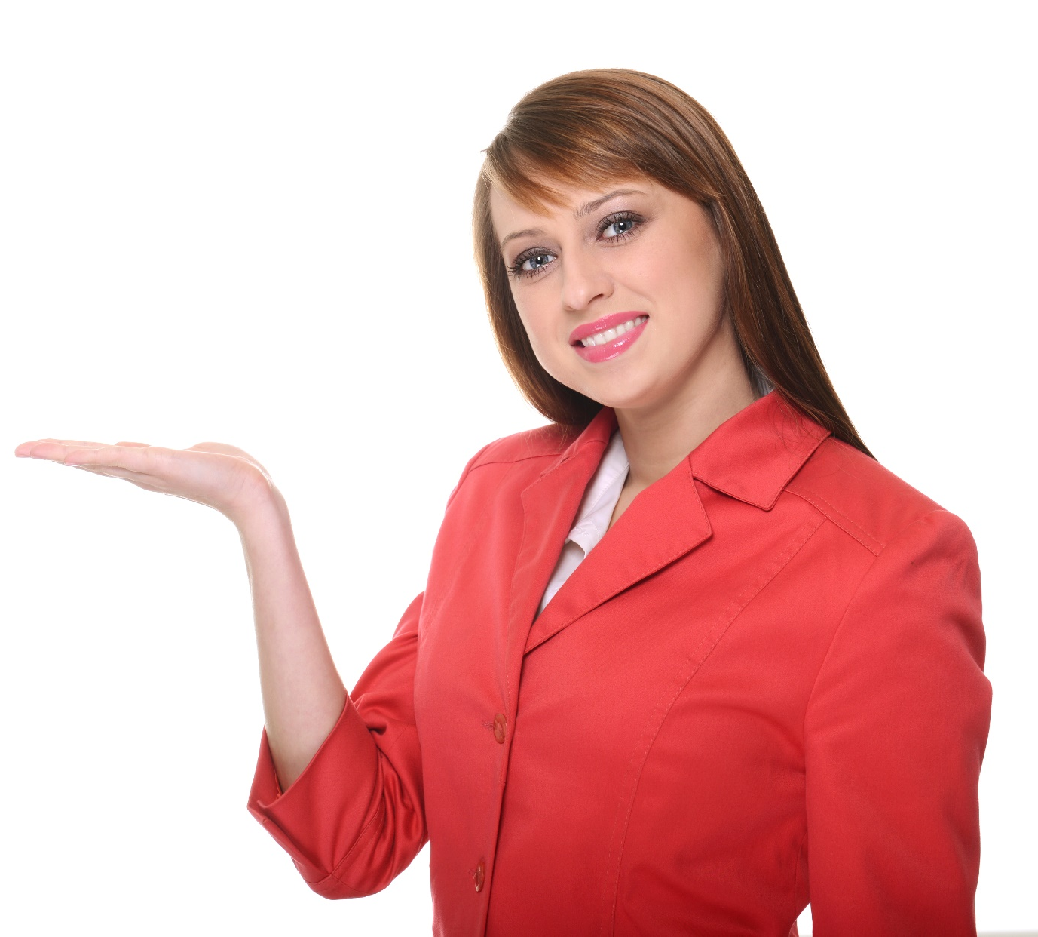
Key Points
Potential Customers
Customers
Past Customers
Example
What not to do
Your next steps
Wrap up

Slide 5
Worksheet
Grab your worksheet and follow along.

Slide 6
Potential Customers
Send ‘nice to meet you’ cards.
Sponsor an event, donate your product, or volunteer.
Send industry email updates and articles of interest.
Smile. Often.
Give referrals.

Slide 7
Actual Customers
Use social media.
Offer loyalty programs, upgrades, special treatment, or customer appreciation and new customer events.
Manage your customer information.
Shine. Show your personality, have positive personal branding, use anecdotes or tell daily jokes; share yourself with your customers.
Get call display.

Slide 8
Past Customers
Newsletters are an easy way to stay in touch with your customers.
Feedback forms are a way of letting your customers know that their opinions matter.
Follow up.

Slide 9
How Does This Work?
 | Likeability Builders
Potential Customers | Offer maps of the mall (could put new sunglass styles and products on the back side). Sign up for the email newsletter that highlights new sunglasses coming out.
Customers | Give free sunscreen with all sunglass purchases. Special loyalty shopper days. Create Facebook group that allows you to try different sunglasses on your photo. Free case with sunglasses.
Past Customers | 1-year anniversary card with a coupon for 20% off. 1-year guarantee on sunglasses. Complimentary sunglass cleaning.

Slide 10
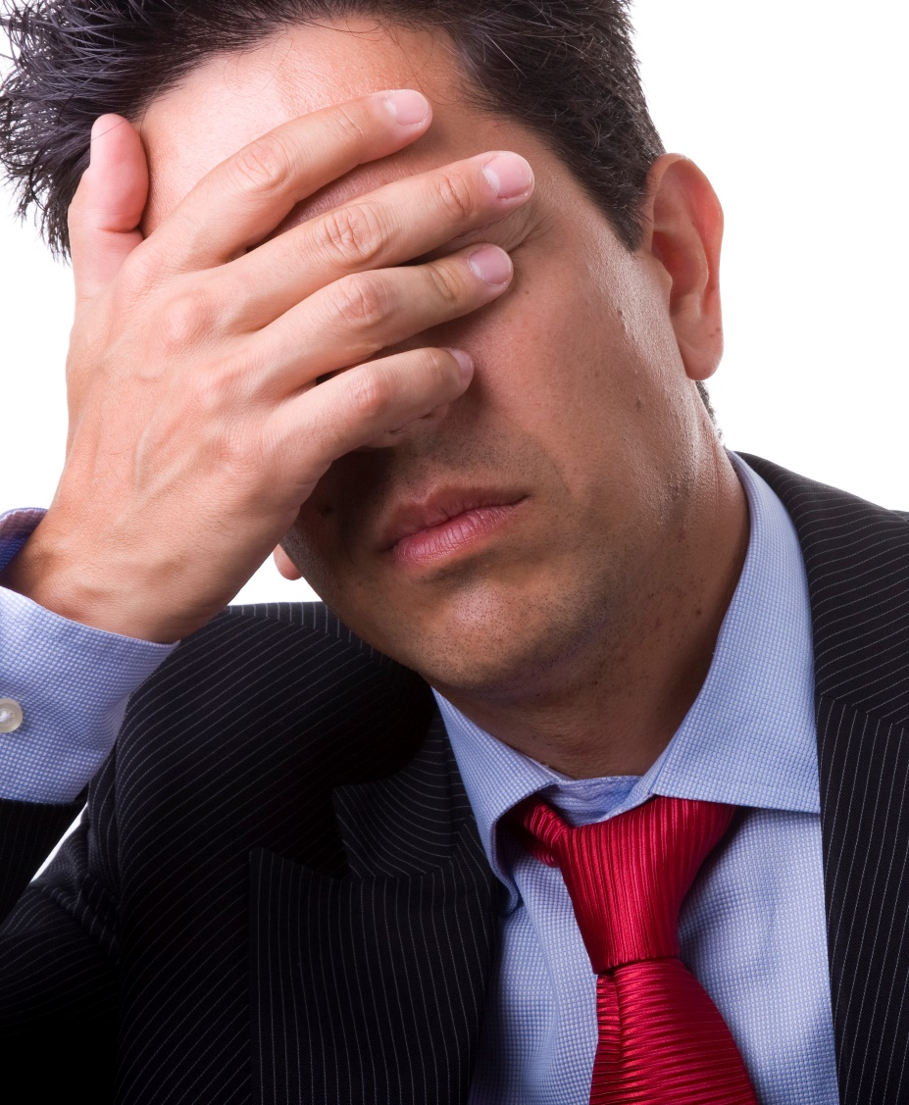
Top Mistakes To Avoid
Taking the attitude that there is no point in being helpful without an immediate payoff.
Not giving.
Neglecting relationships with one type of customer.
Judging someone by how they look.
Pushing too much.
Trying too hard.

Slide 11
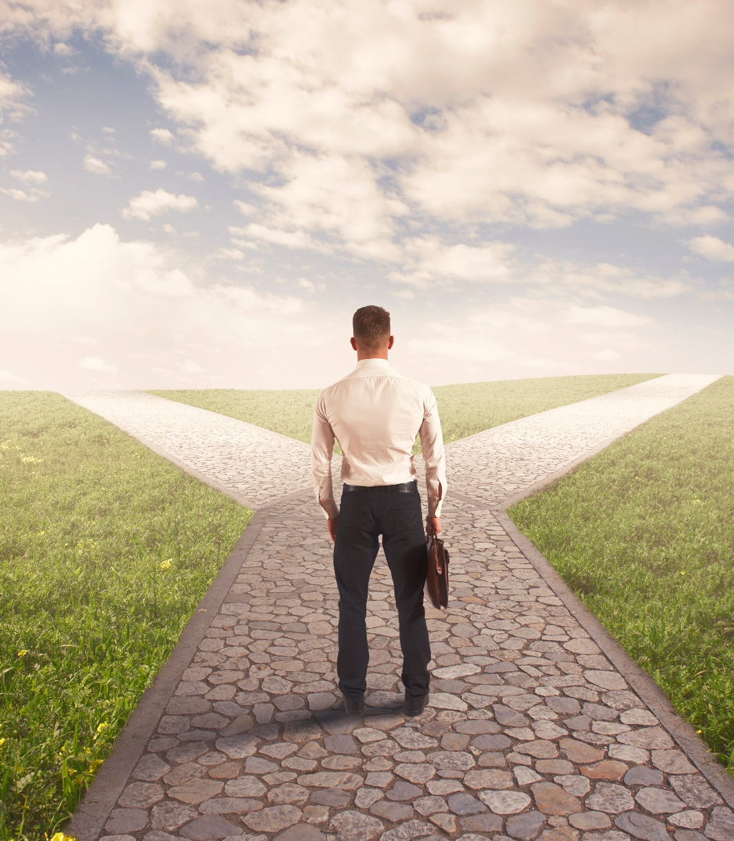
Now What?
Figure out where you are not actively building a customer relationship.
Be creative in how you choose to build a relationship.
Make sure that you are doing something to build your likeability with future, current and past customers.
Relationships and likeability are built differently with different target customers.
Never stop giving.

Slide 12
Key Points
Potential Customers
Customers
Past Customers
Example
What not to do
Your next steps
Wrap up

Slide 13
The Goal
Have the tools to start off a positive relationship and build it.

Slide 14
Give to ten people and one person will give back.

