Slide 1
Small Business Solver| Small Business Advice at your Fingertips
Providing the Most Up to Date and Comprehensive Set of Tools, Webinars and Resources for Small Business
Notes:
Content slide

Slide 2
Small Business Solver| Small Business Advice at your Fingertips
Challenges Facing Small Businesses
What is Small Business Solver?
E Learning Programs
Subscriber Benefits
Leveraging for Your Organization
Notes:
Table of Contents
Blue to white transition
Picture of the i-pad “flys in from top” behind the top header
Presentation topics then fade in on click one at a time

Slide 3
Small Business Solver| Small Business Advice at your Fingertips
Challenges Facing Small Businesses
Notes:
Grey title slide

Slide 4
Small Business Solver| Challenges Facing Small Business
Time – not enough time in the day
Timing – access to information when they need it
Complexity – many challenges and opportunities
Resources – where to go and find information to help them, fast, easily and in one place
Learning specifics eg. sales, marketing, planning
Resources – affordable
Notes:
Grey title slide

Slide 5
Small Business Solver| Small Business Advice at your Fingertips
What is Small Business Solver?
Notes:
Grey title slide

Slide 6
Small Business Solver| What is Small Business Solver?
A comprehensive set of tools to address the complex needs from aspiring to existing small business owner
Business Planning = Business template + 48 worksheets
Financial Modules = 10 topics include everything from understanding your numbers through to sales forecasting.
Idea Testing = 1 book – interactive 8 questions to get you started and figure out what are the red flags for your business concept
Marketing Modules = 30 topics include personal packaging, materials, CRM, trade shows, building strategic alliance
Sales = 50 topics include understanding sales funnel, closing, handling objectives, sales mindset and motivation
Start Up = 46 moving into becoming entrepreneur, what you need to know.
Strategy = 48 topics everything from thinking to closing your business
Webinars = 25+
Notes:
Grey title slide

Slide 7
Small Business Solver| Small Business Advice at your Fingertips
E Learning Programs
Notes:
Grey title slide

Slide 8
Small Business Solver| E Learning Programs
Weekly e learning series designed to get results
Your Small Business Marketing Campaign - Getting your marketing started and successful ( 4 weeks)
Your Sales Strategy - This learning track gets your sales on track. (4 weeks)
Small Business Selling 101 - Use this learning track to give yourself the basics on selling, to improve your close rate, or to train new sales employees. (50 weeks)
Starting Up a Business - Use this learning track to follow the key stages of ramping up your business, making critical decisions, and keeping up the momentum. (32 weeks)
SEB Business Plan Program - The Self-Employment Benefit Program requires that a business plan is developed within the first 8 weeks. This learning track helps with moving forward and tracking progress. (32 weeks)
A Business Plan For Yourself - Use this learning track to start heading down the right track – action oriented and focused on the vision for your business (4 weeks)
An Action Plan For Yourself -Creating an action plan is critical to moving forward. Self-discipline and positive action. Use this learning track to get on track. (4 weeks)
Notes:
Grey title slide

Slide 9
Small Business Solver| Small Business Advice at your Fingertips
Subscriber Benefits
Notes:
Grey title slide

Slide 10
Small Business Solver| Subscriber Benefits
Business Tools and Resources at Your Fingertips
Interactive Tools to access and provide resources to move your business forward
Webinars on pertinent topics, live and recorded
Financial Templates – Sales, Marketing, Balance Sheet, Income Statement and Cash Flow
Subscriber Savings and Discounts
Notes:
Grey title slide

Slide 11
Small Business Solver| Interactive Tools
Interative Tools – pinpoint and prioritize
All of the small business tools are designed to be intereactive and based on self-learning.
Watch a one-minute tutorial to get the most out of it.
Business Solver Tutorial: How to figure out what to do when you don’t know where to start.
Notes:
Grey title slide

Slide 12
Small Business Solver| Interactive Tools
Planning Solver Tutorial: Assistance in writing your own business plan, the easiest way possible.
Finance Solver Tutorial: Step-by-step explanations of how to use the Planning Solver Financial Template to complete financial projections in minutes.
Marketing Solver Tutorial: Quickly see what marketing tools make sense for you using an advanced search of 300 options.
Notes:
Grey title slide

Slide 13
Small Business Solver| Interactive Tools
Sales Solver Tutorial: Target different parts of your sales funnel to improve your sales dramatically.
Calculators
The Idea Tester Tutorial: Finding out what your break-even and if you will be working longer hours than you want in just 8 questions.
Notes:
Grey title slide

Slide 14
Small Business Solver| Interactive Tools
Business Solver Questionnaire Tutorial: How to figure out what to do when you don’t know where to start.
Sales Solver Calculator Tutorial: Figure out what part of your sales funnel needs the most attention to improve your sales.
Notes:
Grey title slide

Slide 15
Interactive Tools - Assessments and Guidance

Slide 16
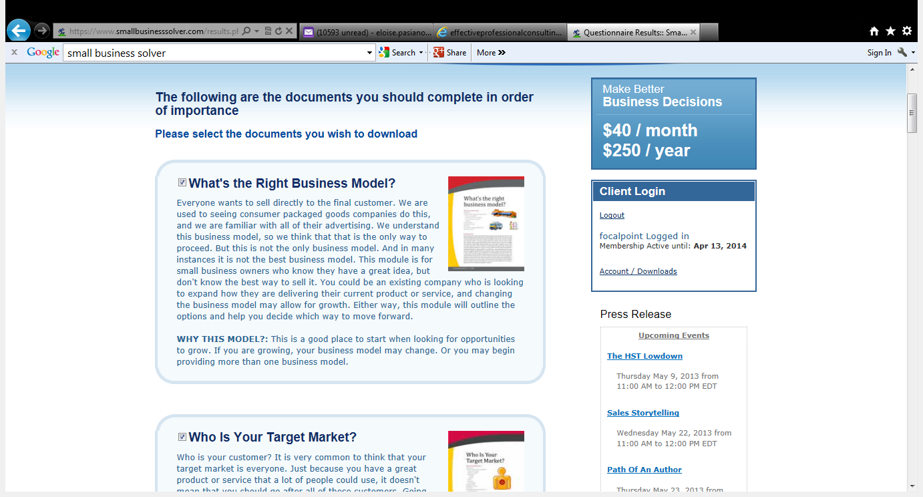
Pinpoint what you need to Focus on

Slide 17
4 pages
Table of Contents
Include an executive summary

Slide 18
The decision making module
Explanation of how to complete it

Slide 19
The Top Things NOT To Do
Action Items

Slide 20
Key Takeaway
Mini Case Study

Slide 21
Clear Learning Objectives and overview

Slide 22
Steps to work through
the topic

Slide 23
What to watch out for and next steps

Slide 24
Great discussion points that need a Trusted Business Coach to help with prioritizing and identifying gaps

Slide 25
Small Business Solver| Small Business Advice at your Fingertips
Financial Templates
Notes:
Grey title slide

Slide 26
Financial Templates – Q&A , Sales, Marketing, Balance Sheet, Income Statement and Cash Flow

Slide 27
Small Business Solver| Small Business Advice at your Fingertips
Savings
Notes:
Grey title slide

Slide 28
Exampe of Small Business Solver Savings Program
With more coming!

Slide 29
Small Business Solver| Small Business Advice at your Fingertips
Leveraging For Your Organization
Notes:
Grey title slide

Slide 30
Small Business Solver| Leveraging For Your Organization
e learning
Webinars
Subscription
Special Offer:
Notes:
Grey title slide

Slide 31
Small Business Solver| Small Business Advice at your Fingertips
Challenges Facing Small Businesses
What is Small Business Solver?
E Learning Programs
Subscriber Benefits
Leveraging for Your Organization
Notes:
Table of Contents
Blue to white transition
Picture of the i-pad “flys in from top” behind the top header
Presentation topics then fade in on click one at a time

